Slide 1

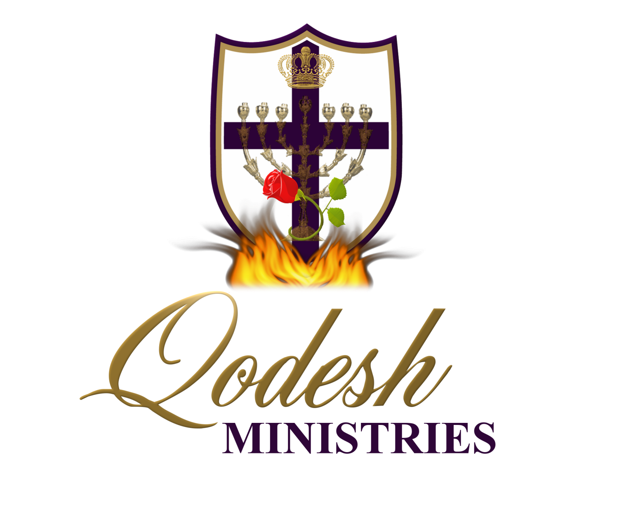

Slide 2
RECOGNITION
THE MESSIANIC PROPHECY BIBLE PROJECT
http://www.messianicbible.com
HEAR O ISRAEL
www.hearoisrael.org
SHEEPFOLD GLEANINGS WRITTEN BY JULIE PARKER
www.sheepfoldgleanings.com
MESSIANIC ISRAEL ALLIANCE
http://www.messianicisrael.com
AZAMRA TORAH FOR OUR TIME – RABBI AVRAHAM GREENBAUM
http://www.azamra.org

Slide 3
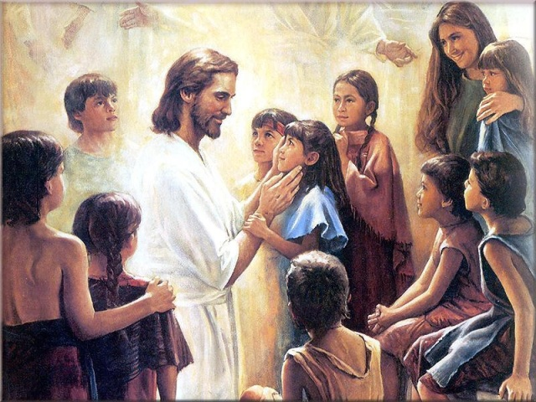
V'ZOT HABERACHAH
“This is the blessing”
TORAH: Deuteronomy 33:1-34:12
HAFTORAH: Joshua 1:1-18
B’RIT CHADASHAH: 1 Thessalonians 5:1-11
All references: The Scripture 1998+ unless otherwise noted

Slide 4
BLESSING
This is the blessing that Moshe, the man of God, spoke over the people of Isra'el before his death: (Deuteronomy 33:1 CJB)
Blessings come forth through the channel of Elohim's Law. It is useless, for instance, to wish for someone's good health and prosperity if his favorite haunt is (and remains) the smoke-filled beer hall [that is, if he/she remains unrepentant, and make no effort to walk with the Master].
A true king wants to bless his subjects as they honor the laws of the kingdom. How much more does Yahweh have a great, irrepressible desire to bless His people. So He told His people, again and again, that His blessings come through the vehicle of His righteous truth.

Slide 5
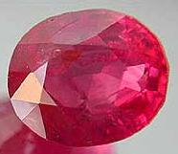
REUBEN (Ruby)
Meaning: “see a son” Genesis 29:32
Stone meaning: Odem, root leads to “daman” which means to submit (Hebrew Chaldean Lexicon by Davidson pg 152)
Prophecy: "Re'uven, you are my firstborn, my strength, the firstfruits of my manhood. Though superior in vigor and power you are unstable as water, so your superiority will end, because you climbed into your father's bed and defiled it — he climbed onto my concubine's couch! (Genesis 49:3-4 CJB)
Blessing: "Let Re'uven live and not die out, even though his numbers grow few." (Deuteronomy 33:6 CJB)

Slide 6
WALKING SUBMITTED
I can't do a thing on my own. As I hear, I judge; and my judgment is right; because I don't seek my own desire, but the desire of the one who sent me. (John 5:30 CJB)
Yahshua was totally submitted, He was and is the perfect forerunner for all mankind through His submission unto death.
For "Whoever wants to love life and see good days must keep his tongue from evil and his lips from speaking deceit, turn from evil and do good, seek peace and chase after it. For Adonai keeps his eyes on the righteous, and his ears are open to their prayers; but the face of Adonai is against those who do evil things." For who will hurt you if you become zealots for what is good? But even if you do suffer for being righteous, you are blessed! Moreover, don't fear what they fear or be disturbed, (1 Peter 3:10-14 CJB)

Slide 7
LACK OF SUBMISSION
What is causing all the quarrels and fights among you? Isn't it your desires battling inside you? You desire things and don't have them. You kill, and you are jealous, and you still can't get them. So you fight and quarrel. The reason you don't have is that you don't pray! Or you pray and don't receive, because you pray with the wrong motive, that of wanting to indulge your own desires. You unfaithful wives! Don't you know that loving the world is hating God? Whoever chooses to be the world's friend makes himself God's enemy! Or do you suppose the Scripture speaks in vain when it says that there is a spirit in us which longs to envy? But the grace he gives is greater, which is why it says, "God opposes the arrogant, but to the humble he gives grace."
(James 4:1-6 CJB)

Slide 8
SUBMIT TO GOD
Therefore, submit to God. Moreover, take a stand against the Adversary, and he will flee from you. Come close to God, and he will come close to you. Clean your hands, sinners; and purify your hearts, you double-minded people! (James 4:7-8 CJB)
The humble receive grace from God. In Greek “the humble” it means the low lying one, to lie low, to lie under. If we are proud and arrogant, Yahweh resists us! So we are entertaining Satan when we are proud.
Rabbi’s teach if we open a gate the size of needle through repentance and humbleness of spirit before Yahweh, He will open the gate up to the size that a camel will go through .

Slide 9
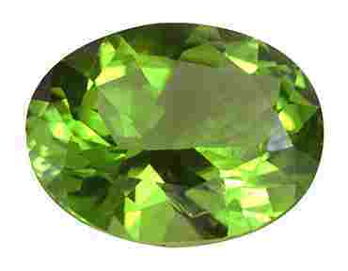
JUDAH (Turquoise)
Meaning: “yadah”, to use the hand [yad], to praise, to give thanks, to consecrate, to worship, to throw an object, to make confession. Genesis 29:35 She conceived again …"This time I will praise the LORD."
Stone meaning: “Nopech” root word is nuphet, the Torah of Yahweh .
Prophecy: "Y'hudah, your brothers will acknowledge you, your hand will be on the neck of your enemies, your father's sons will bow down before you. Y'hudah is a lion's cub; my son, you stand over the prey. He crouches down and stretches like a lion; like a lioness, who dares to provoke him? The scepter will not pass from Y'hudah, nor the ruler's staff from between his legs, until he comes to whom [obedience] belongs; [or: until Shiloh comes] and it is he whom the peoples will obey. Tying his donkey to the vine, his donkey's colt to the choice grapevine, he washes his clothes in wine, his robes in the blood of grapes. His eyes will be darker than wine, his teeth whiter than milk. (Genesis 49:8-12 CJB)

Slide 10
YUDAH THE LION
Of Y'hudah he said: "Hear, Adonai, the cry of Y'hudah! Bring him in to his people, let his own hands defend him; but you, help him against his enemies.“ (Deuteronomy 33:7 CJB)
Judah was always the first tribe into battle as they led the way it is in them, to protect the tribe and as a army to follow instruction.
“Judah is a lion's whelp;” – “Lion’s whelp” in Hebrew means to turn aside, to fear, to gather for hostility. To be mischievous always in trouble.
“He stooped down, he couched as a lion, ” – stage of manhood, or strength of man. Also symbolises a young violent, aggressive, hunter.
“as a lioness; who shall rouse him up?” – a great old lion, one of maturity, or the third stage of man as he becomes aged wise and older.

Slide 11
BLESSING
“The scepter shall not depart from Judah,” - The blessing of kingship was given to Judah.
You said, "I made a covenant with the one I chose, I swore to my servant David, 'I will establish your dynasty forever, build up your throne through all generations.' " (Selah) (Psalms 89:3-4 CJB)
Fulfilment: One of the elders said to me, "Don't cry. Look, the Lion of the tribe of Y'hudah, the Root of David, has won the right to open the scroll and its seven seals.“ (Revelation 5:5 CJB)
“nor the ruler's staff from between his feet,” – the ruler is the one who imposes and governs the instructions as given to him. The staff is a symbol of that authority to preserve the Word of until the return of Yahshua.
Yeshua came and talked with them. He said, "All authority in heaven and on earth has been given to me. (Matthew 28:18 CJB)

Slide 12
WASHING OF GARMENTS
‘he washeth his garments in wine, and his vesture in the blood of grapes; His eyes shall be red with wine, and his teeth white with milk.” This refers to the washing of ourselves in the blood of the Lamb for the removal of sins.
"Come now," says Adonai, "let's talk this over together. Even if your sins are like scarlet, they will be white as snow; even if they are red as crimson, they will be like wool. If you are willing and obedient, you will eat the good of the land; (Isaiah 1:18-19 CJB)

Slide 13
INSTRUCTION
Protector of the instructions of God
Torah – simply means precept, teaching or instruction. Comes from the root word “yarah” meaning to shoot the arrow and hit the mark.
The root word for Yudah is “yadah” to throw and arrow, spear or rock. “sin” means to miss the mark
Then what advantage has the Jew? What is the value of being circumcised? Much in every way! In the first place, the Jews were entrusted with the very words of God. (Romans 3:1-2 CJB)
(3:22) "Remember the Torah of Moshe my servant, which I enjoined on him at Horev, laws and rulings for all Isra'el. (Malachi 4:4 CJB)

Slide 14
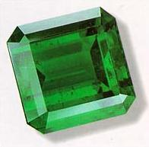
LEVI (Emerald)
Meaning: “Attached, joined, united, knotted”
Stone meaning: Beraket, root is “barag” to give light
Prophecy: Simeon and Levi are two of a kind, ready to fight …. They kill men in fits of temper, slash oxen on a whim…. A curse on their uncontrolled anger, on their indiscriminate wrath. I'll shred and scatter them like confetti throughout Israel. Genesis 49:5-8
Blessing: Of Levi he said: "Let your tumim and urim be with your pious one, whom you tested at Massah, with whom you struggled at M'rivah Spring. Of his father and mother he said, 'I don't know them'; he didn't acknowledge his brothers or children. For he observed your word, and he kept your covenant. They will teach Ya`akov your rulings, Isra'el your Torah. They will set incense before you and whole burnt offerings on your altar. Adonai, bless his possessions, accept the work he does; but crush his enemies hip and thigh; may those who hate him rise no more.“ (Deuteronomy 33:8-11 CJB)

Slide 15
THUMMIM AND URIM
Two stones placed in a little pouch in the folded breastplate. Used by the high priest to guide the Israelites. On the stones where inscribed the name of Yahweh.
Symbolism: To guide is to shine a light on a situation. The Levites were teachers of the Word, the light bearers in the Old Testament
The tribe of Simeon means “purity” and Levi “to give light”. Totally opposite of their actions and because of this they are cursed and scattered throughout the other tribes because of their anger problems. The two are knitted together in disobedience and darkness.
Your words are a doorway that lets in light, giving understanding to the thoughtless. (Psalms 119:130 CJB)
For the mitzvah is a lamp, Torah is light, and reproofs that discipline are the way to life. (Proverbs 6:23 CJB)

Slide 16
NEW TESTAMENT BLESSING
"You are light for the world. …(Matthew 5:14 CJB)
Yeshua spoke to them again: "I am the light of the world; whoever follows me will never walk in darkness but will have the light which gives life.“ (John 8:12 CJB)
Like the menorah in the Tabernacle we are the light of the World through the spirit of God the Rauch haKodesh that now resides in us.
In the same way, let your light shine before people, so that they may see the good things you do and praise your Father in heaven. (Matthew 5:16 CJB)

Slide 17
LIVING IN THE LIGHT
For God did not send the Son into the world to judge the world, but rather so that through him, the world might be saved. Those who trust in him are not judged; those who do not trust have been judged already, in that they have not trusted in the one who is God's only and unique Son. "Now this is the judgment: the light has come into the world, but people loved the darkness rather than the light. Why? Because their actions were wicked. For everyone who does evil things hates the light and avoids it, so that his actions won't be exposed. But everyone who does what is true comes to the light, so that all may see that his actions are accomplished through God."
(John 3:17-21 CJB)

Slide 18
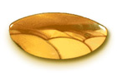
BENJAMIN (Jasper)
Meaning: son of my right hand
Stone meaning: “yashfeh” the root is yashefah which is Yahweh is our strength
Blessing: Of Binyamin he said: "Adonai's beloved lives securely. He protects him day after day. He lives between his shoulders.“ (Deuteronomy 33:12 CJB)
Prophecy: "Binyamin is a ravenous wolf, in the morning devouring the prey, in the evening still dividing the spoil.“ (Genesis 49:27 CJB)
The symbol for the tribe of Benjamin was a wolf. It is believed this was given after what happened to Rachel at his birth. That actually her uterus or womb was torn, and she actually bled to death in giving birth. Rachel was literally torn apart like a wolf tearing flesh whilst eating. Symbolic meaning: When he is young he only cares about himself, and when he is older and more mature he become the elder and shares his prey and helps kill the prey.

Slide 19
SHARING THE SPOIL
After this ordeal, he will see satisfaction. "By his knowing [pain and sacrifice], my righteous servant makes many righteous; it is for their sins that he suffers. Therefore I will assign him a share with the great, he will divide the spoil with the mighty, for having exposed himself to death and being counted among the sinners, while actually bearing the sin of many and interceding for the offenders.“ (Isaiah 53:11-12 CJB)
When the Messiah comes back He is going to divide the spoil of His inheritance with His followers, over comers. For we are coming back to rule and reign with Him we aren't just going to sit in heaven all day.

Slide 20
SONS OF MY RIGHT HAND
.. Rachel went into labor, and she had great difficulty with it. .. As she was dying she named her son Ben-Oni [son of my grief], but his father called him Binyamin [son of the right hand, son of the south]. (Genesis 35:16-18 CJB)
Every son and every stone was always named by the mother, this is the first son that the Jacob names. Benjamin is a type of Messiah seated on the right hand of the Father. It was also the only son to born after Jacob was given the name Israel – “he who rules as Yahweh rules”.
Ben-Oni
Ben means: son or a builder of a household, or family.
Oni means: to exert one’s self in vain, to come to naught, or affliction, evil, or even false idol.
Benjamin
Yamin means: the right hand, right side, right leg, or right eye.
We are can also see that Jacob could be referring to the son of Rachel, his right hand, his wife.

Slide 21
WARRIORS
Your right hand, Adonai, is sublimely powerful; your right hand, Adonai, shatters the foe. (Exodus 15:6 CJB)
It is the right hand of Yahweh that crushes the enemy as it did pharaoh and his armies and cast them into the sea. The right hand is a symbol of the first born blessing, which is the double portion.
So if you were raised along with the Messiah, then seek the things above, where the Messiah is sitting at the right hand of God. Focus your minds on the things above, not on things here on earth. For you have died, and your life is hidden with the Messiah in God. (Colossians 3:1-3 CJB)
If we look in 1 Chronicles 12:16, 18 and 29 we see that the tribe of Benjamin was one of the first one to gather themselves with David. The had some left handed archers who never missed the mark. It almost ironic that a tribe whose name means son of my right hand where left handed and they never missed the mark. Another word for sin – missing the mark.

Slide 22
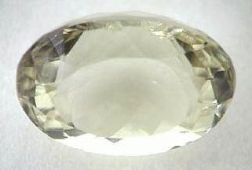
JOSEPH (Onyx)
Meaning: Yahweh has added to me another son
Stone meaning: “Shocham” the root is cham which is zeal, or jealousy. Another translation - he will collect or gather
Blessing: Of Yosef he said: "May Adonai bless his land with the best from the sky, for the dew, and for what comes from the deep beneath, with the best of what the sun makes grow, with the best of what comes up each month, with the best from the mountains of old, with the best from the eternal hills, with the best from the earth and all that fills it, and the favor of him who lived in the [burning] bush. May blessing come on the head of Yosef, on the brow of the prince among his brothers. His firstborn bull - glory is his; his horns are those of a wild ox; With them he will gore the peoples, all of them, to the ends of the earth. These are the myriads of Efrayim; these are the thousands of M'nasheh.“ (Deuteronomy 33:13-17 CJB)

Slide 23
THE VINE
"Yosef is a fruitful plant, a fruitful plant by a spring, with branches climbing over the wall. The archers attacked him fiercely, shooting at him and pressing him hard; but his bow remained taut; and his arms were made nimble by the hands of the Mighty One of Ya`akov, from there, from the Shepherd, the Stone of Isra'el, by the God of your father, who will help you, by El Shaddai, who will bless you with blessings from heaven above, blessings from the deep, lying below, blessings from the breasts and the womb. The blessings of your father are more powerful than the blessings of my parents, extending to the farthest of the everlasting hills; they will be on the head of Yosef, on the brow of the prince among his brothers. (Genesis 49:22-26 CJB)
.“Joseph is a fruitful vine” – Jesus the vine - John 15:1 "I am the true vine, and my Father is the gardener.

Slide 24
SEPERATED
“Let all these rest on the head of Joseph, on the brow of the prince among his brothers.” Joseph is separated from his brothers through his position. The Hebrew word is “Nazyir” – one who is set apart, or holy, completely to Yahweh a Nazarite.
Yeshua: So too Yeshua suffered death outside the gate, in order to make the people holy through his own blood. (Hebrews 13:12 CJB)
Us: But when God, who picked me out before I was born and called me by his grace, chose (Galatians 1:15 CJB)
I exhort you, therefore, brothers, in view of God's mercies, to offer yourselves as a sacrifice, living and set apart for God. This will please him; it is the logical "Temple worship" for you.
(Romans 12:1 CJB)

Slide 25
ZEALOUS
Brothers, my heart's deepest desire and my prayer to God for Isra'el is for their salvation; for I can testify to their zeal for God. But it is not based on correct understanding; for, since they are unaware of God's way of making people righteous and instead seek to set up their own, they have not submitted themselves to God's way of making people righteous. (Romans 10:1-3 CJB)
On hearing it, they praised God; but they also said to him, "You see, brother, how many tens of thousands of believers there are among the Judeans, and they are all zealots for the Torah. (Acts 21:20 CJB)
My advice to you is to buy from me gold refined by fire, so that you may be rich; and white clothing, so that you may be dressed and not have to be ashamed of your nakedness; and eyesalve to rub on your eyes, so that you may see. As for me, I rebuke and discipline everyone I love; so exert yourselves, and turn from your sins! Here, I'm standing at the door, knocking. If someone hears my voice and opens the door, I will come in to him and eat with him, and he will eat with me. (Revelation 3:18-20 CJB)

Slide 26
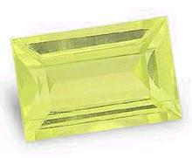
ZEBULUN (Beryl)
Meaning: means to dwell
Stone meaning: “tarshish” roots of this word “tarash” meaning to reverence
Prophecy: "Z'vulun will live at the seashore, with ships anchoring along his coast and his border at Tzidon. (Genesis 49:13 CJB)
Blessing: Of Z'vulun he said: "Rejoice, Z'vulun, as you go forth, and you, Yissakhar, in your tents. They will summon peoples to the mountain and there offer righteous sacrifices; for they will draw from the abundance of the seas and from the hidden treasures of the sand.“ (Deuteronomy 33:18-19 CJB)
The symbol of Zebulun is ships: Seas are symbolic of a lot of people, the word haven is “choph” Sidon in Hebrew means to “catch fish” or fisherman. So Zebulun like to fish for men, that is why they love to be in seas of people.
Yeshua said to them, "Come, follow me, and I will make you into fishers for men!“ (Mark 1:17 CJB)

Slide 27
SCRIBE
From Efrayim came those rooted in `Amalek. Behind you, Binyamin is with your peoples. From Makhir the commanders marched down, and from Z'vulun those holding the musterer's staff. (Judges 5:14 CJB)
“Shebet” – in the Hebrew; to branch off, a stick used for punishing, writing, fighting ruling, walking, correction, a rod, a sceptre, a staff, or a staff of a tribe.
In Hebrew writer is “saphar” – to tally, to record, to speak , to tell, a writer.
So we find out that Zebulun is one who knows the Word of Yahweh. We know that the Word is used for doctrine, correction, admonition, for edification; all these definition describe the scribes pen exactly for the Word of Yahweh

Slide 28
REVERENCE
Looking at the stone one of the attribute we are going to have to possess if we are to become Yahweh Shammah and to enter into Yahweh Shammah is to reverence God.
He sent redemption to his people and decreed that his covenant should last forever. His name is holy and fearsome - the first and foremost point of wisdom is the fear of Adonai; all those living by it gain good common sense. His praise stands forever. (Psalms 111:9-10 CJB)
Holy (Reverend KJV) yârê‘ - A primitive root; to fear; morally to revere; causatively to frighten: be (make) afraid, dread (-ful), (put in) fear. (be had in) reverence (-end), X see, terrible (act, -ness, thing).

Slide 29
REVERE HIS NAME
He sent redemption to his people and decreed that his covenant should last forever. His name is holy and fearsome - (Psalms 111:9 CJB)
The most critical people are those that go to a church where the Pastor takes on the title or reverend, rabbi or father. Scripture is very clear there is one name that is to be revered.
Yahweh’s name is to feared
Yahweh’s name is to be dreaded
Yahweh’s name is to be frightened of
We treat the set apart things of Yahweh as though they are profane. The way we treat the Word of God, the things of God etc, we have no respect.
So, my dear friends, just as you have always obeyed when I was with you, it is even more important that you obey now when I am away from you: keep working out your deliverance with fear and trembling, (Philippians 2:12 CJB)

Slide 30
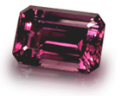
ISSACHAR (Amethyst)
Meaning: means will bring a reward
Stone meaning: “Achlamah” roots of this word “challam” meaning to join closely
Prophecy: "Yissakhar is a strong donkey lying down in the sheep sheds. On seeing how good is settled life and how pleasant the country, he will bend his back to the burden, and submit to forced labor. (Genesis 49:14-15 CJB)
The term forced labour comes from the word “Abad” meaning: to work, to serve, to keep in bondage, a bondservant, to compel, to labour. Issachar was willing to become a bond servant to work for the rest of His life as a servant to his master and never leave the master’s house.
Yet he finds rest on the Sabbath he lays down his burdens and worships Yahweh and he find the resting place good.

Slide 31
BLESSING
Of Z'vulun he said: "Rejoice, Z'vulun, as you go forth, and you, Yissakhar, in your tents. They will summon peoples to the mountain and there offer righteous sacrifices; for they will draw from the abundance of the seas and from the hidden treasures of the sand.“ (Deuteronomy 33:18-19 CJB)
They have the ability to bring the best out of people, the riches out of people, out of the seas. In order to understand this characteristic we need to look at marriage. We have to understand that Yahweh wants a family, that is why we where created. Yahweh wants a family that will raise righteous seed unto Himself. If we understand the relationship that he wants with Israel then you will understand the relationship that he wants us to have with Him: that is the one of marriage.

Slide 32
SABBATH AND BURDENS
.. "If you value your lives, don't carry anything on Shabbat or bring it in through the gates of Yerushalayim; don't carry anything out of your houses on Shabbat; and don't do any work. Instead, make Shabbat a holy day. I ordered your ancestors to do this, but they neither listened nor paid attention; rather, they stiffened their necks, so that they wouldn't have to hear or receive instruction. However, if you will pay careful heed to me," says Adonai "and carry nothing through the gates of this city on Shabbat, but instead make Shabbat a day which is holy and not for doing work; then kings and princes occupying the throne of David will enter through the gates of this city, riding in chariots and on horses. ..They will come from the cities of Y'hudah, from the places surrounding Yerushalayim, from the land of Binyamin, from the Sh'felah, from the hills and from the Negev, bringing burnt offerings, sacrifices, grain offerings, frankincense and thanksgiving sacrifices to the house of Adonai. But if you will not obey me and make Shabbat a holy day and not carry loads through the gates of Yerushalayim on Shabbat, then I will set its gates on fire; it will burn up the palaces of Yerushalayim and not be quenched." ' “ (Jeremiah 17:20-27 CJB)

Slide 33
TO YOKE TOGETHER
…, 'For this reason a man should leave his father and mother and be united with his wife, and the two are to become one flesh'? Thus they are no longer two, but one. So then, no one should split apart what God has joined together.“ (Matthew 19:5-6 CJB)
The Greek word for cleaving is “Suzeagnumi” meaning: joined together, joined in marriage, a yoke together, two people in a yoke.
Nevertheless, brothers, I call on you in the name of our Lord Yeshua the Messiah to agree, all of you, in what you say, and not to let yourselves remain split into factions but be restored to having a common mind and a common purpose. (1 Corinthians 1:10 CJB)
The word united means to be joined or mended “kartartizo” to complete thoroughly, thus we must be joined in the same opinion.

Slide 34
BECOME ONE
.. and they are to be one flesh. (Genesis 2:24 CJB)
Becoming one “echad” united, become alike, alone, they become one, they become only, the become together.
Cleave “debak” means to cling, to adhere, to abide, to cleave fast together, to stick, to be joined together, to join closely. So to be married is to become is to cleave together to become one and that is the significance of the stone “join closely”
"I pray not only for these, but also for those who will trust in me because of their word, that they may all be one. Just as you, Father, are united with me and I with you, I pray that they may be united with us, ..The glory which you have given to me, I have given to them; so that they may be one, just as we are one —I united with them and you with me, so that they may be completely one, and the world thus realize that you sent me, and that you have loved them just as you have loved me. (John 17:20-23 CJB)

Slide 35
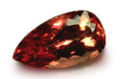
GAD (Jacinth)
Meaning: Gad means troop, fortune, invade or attack
Stone meaning: “leshem” roots of this word meaning shem or name
Prophecy: "Gad [troop] — a troop will troop on him, but he will troop on their heel. (Genesis 49:19 CJB) So we have troop versus a troop, or another meaning gad was His own worst enemy attacking himself. Sometime we are our own worst enemies
Blessing: Of Gad he said: "Blessed is he who makes Gad so large; he lies there like a lion, tearing arm and scalp. He chose the best for himself when the princely portion was assigned. When the leaders of the people came, he carried out Adonai's justice and his rulings concerning Isra'el.“ (Deuteronomy 33:20-21 CJB). There is a blessing for those who help enlarge Gad, there is a blessing in store who help spread the message of the Good news of Yahshua.

Slide 36
BABYLONIAN GAD
"But as for you who abandon Adonai, who forget my holy mountain, who prepare a table for Gad, a god of luck, and fill bowls of mixed wine for Meni, a god of destiny —(Isaiah 65:11 CJB)
Meaning: gâd, gawd, From H1464 fortune: - troop.
Gawd/God - the common tectonic (pertaining to construction or architecture) word for a personal object of religious worship, and applies to all those super human beings in the heathen mythologies in Encyclopaedia Britannica. Webster “ the word is common to tectonic tongues and it was applied to heathen deities, and later when the tectonic peoples where converted to Christianity, the word was elevated to the Christian sense
If translated incorrectly translators could use the name of Gawd/God for the name of Yahweh.

Slide 37
SHIELD AND SWORD
(12:9) From the Gadi a number of strong, brave, trained fighting men defected to David at the fortress in the desert. They could handle shield and spear, they were as fierce as lions, and they were as fast as deer on the hills: (1 Chronicles 12:8 CJB)
Gad also walks around like a mature seasoned lion – “Lebaot”. The tribe of gad is also fierce warriors and go directly for the crown.
Always carry the shield of trust, with which you will be able to extinguish all the flaming arrows of the Evil One. And take the helmet of deliverance; along with the sword given by the Spirit, that is, the Word of God; (Ephesians 6:16-17 CJB)
The Gadites have great faith, and are always fighting in the spirit. Mostly intercessors around you, that are fierce in spiritual combat and battle.

Slide 38
ONLY REASON FOR DEATH
Yeshua said to him, "The words are your own. But I tell you that one day you will see the Son of Man sitting at the right hand of HaG'vurah and coming on the clouds of heaven." At this, the cohen hagadol tore his robes. "Blasphemy!" he said. "Why do we still need witnesses? You heard him blaspheme! (Matthew 26:64-65 CJB)
Some bibles say the “almighty one”. Matthew could not use the real name Jesus used to described God because it was under a ban. It is that exact ban that God Jesus crucified. From the oral tradition the only way a person could be put to death on the charge of blasphemy was if he uttered the Tetragramaton – Yahweh. There was no other charge against Jesus.

Slide 39
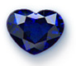
DAN (Sapphire)
Meaning: “dun”, it means to rule, to judge, to strive, to contend with, to execute judgement, to plead a cause, to discern.
Stone meaning: “Saphir” meaning book, the book of Yahweh
Prophecy: "Dan will judge his people as one of the tribes of Isra'el. Dan will be a viper on the road, a horned snake in the path that bites the horse's heels so its rider falls off backward. I wait for your deliverance, Adonai. (Genesis 49:16-18 CJB) The above prophecy is a bit of word play from the original curse spoken over satan in the garden of Eden. I will put animosity between you and the woman, and between your descendant and her descendant; he will bruise your head, and you will bruise his heel." (Genesis 3:15 CJB). A tribe that will do the same as satan for different reasons.
Blessing: Of Dan he said: "Dan is a lion cub leaping forth from Bashan.“ (Deuteronomy 33:22 CJB)

Slide 40
SONS OF DAN
Dan married an Edomite a descendant of Esau: Esau was rebellious, did not care about birthright. When the kingdom of Israel split one of the golden calves were placed at Dan.
But when they went into Mikhah's house and took the silver-covered image, the vest and the household gods, the cohen asked them, "What are you doing?" They replied, "Be quiet, keep your mouth shut, and come with us. Be a father and a cohen for us. Which is better? To be a cohen in the house of one man or to be cohen to a whole tribe and family in Isra'el?" This made the cohen feel very good; so he took the ritual vest, the household gods and the image and went off with the people. (Judges 18:18-20 CJB)
They named the city Dan, after Dan their ancestor, who was born to Isra'el; although the city had previously been called Layish. The people of Dan set up the image for themselves. Y'honatan the son of Gershom, the son of M'nasheh, and his sons were cohanim for the tribe of the people of Dan until the day of the exile from the land. (Judges 18:29-30 CJB)

Slide 41
APPROVED BY GOD
"If you will not observe and obey all the words of this Torah that are written in this book, so that you will fear this glorious and awesome name, Adonai your God; then Adonai will strike down you and your descendants with extraordinary plagues and severe sicknesses that go on and on. He will bring back upon you all the diseases the Egyptians had, which you were in dread of; and they will cling to you. Not only that, but Adonai will bring upon you all the sicknesses and plagues that are not written in this book of the Torah - until you are destroyed. (Deuteronomy 28:58-61 CJB)
Do all you can to present yourself to God as someone worthy of his approval, as a worker with no need to be ashamed, because he deals straightforwardly with the Word of the Truth. (2 Timothy 2:15 CJB)
Samson was a Danite used to judge the Philistines.
Used twice to build the fathers house: Exodus 35:34, 2 Chronicles 2:13-14 NIV

Slide 42
JUDGED BY THE WORD
Stop judging by surface appearances, and judge the right way!“ (John 7:24 CJB)
If anyone hears what I am saying and does not observe it, I don't judge him; for I did not come to judge the world, but to save the world. Those who reject me and don't accept what I say have a judge — the word which I have spoken will judge them on the Last Day. (John 12:47-48 CJB)
What Yahshua is saying it will be the very words that He has spoken that will judge us. The word of the torah, prophets and writings. He didn’t have anymore to say as because He wrote the word and he is the Living Torah incarnate. He was showing what Torah looked like when it was lived out by a Man who kept the Torah, who was truly righteous.

Slide 43
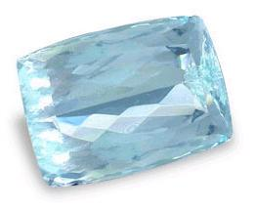
NAPHTALI (Diamond)
Meaning: root word “tathal” it means to “you struggle, to wrestling, go forward, to be torturerous, to twine.
Stone meaning: “yahalom” meaning to heal
Prophecy: "Naftali is a doe set free that bears beautiful fawns. [or: that says beautiful words.] (Genesis 49:21 CJB). The tribe of Naphtali are reckless as a deer, very swift and untamed.
Blessing: Of Naftali he said: "You, Naftali, satisfied with favor and full of blessing from Adonai, take possession of the sea and the south.“ (Deuteronomy 33:23 CJB) . God likes the free spirit of the Deer in Naphtali, thus it brings great favour in the eyes of the Lord, but this free spirit must be channelled in the right direction otherwise idolatry will creep in.

Slide 44
DISOBEDIENCE /OBEDIENCE
Naftali did not drive out the inhabitants of Beit-Shemesh or Beit-`Anat but lived among the Kena`ani living in the land; however, the inhabitants of Beit-Shemesh and Beit-`Anat became forced labor for them. (Judges 1:33 CJB)
Because of their free spirit they allowed the people to live and with that still worship the God’s. In the inhabitants are known as the house of the rising sun or sun worshippers.
(3:20) But to you who fear my name, the sun of righteousness will rise with healing in its wings; and you will break out leaping, like calves released from the stall. (Malachi 4:2 CJB)
Once again the opposite is expected from the children of God. And when we receive the healing from Yahshua we will leap like young calves in a stall.

Slide 45
GREAT STRUGGLE
Rachel said, "I have wrestled mightily with my sister and won," and called him Naftali [my wrestling]. (Genesis 30:8 CJB)
(32:25) and Ya`akov was left alone. Then some man wrestled with him until daybreak. (Genesis 32:24 CJB)
Notes:
Naphtali means “my struggle” not your struggle.
The wrestling with Jacob takes place at night, night is symbolic of darkest period in life, a time when all seems hopeless.
When we struggle we are normally alone.
God will place you into a situation where you must wrestle with Him, you must wrestle with yourself, because He is bring change in your life.
For Adonai disciplines those he loves and whips everyone he accepts as a son.“ (Hebrews 12:6 CJB)

Slide 46
OUR STRENGTH
(32:26) When he saw that he did not defeat Ya`akov, he struck Ya`akov's hip socket, so that his hip was dislocated while wrestling with him. (Genesis 32:25 CJB)
When the Messiah was executed on the stake as a criminal, I was too; so that my proud ego no longer lives. But the Messiah lives in me, and the life I now live in my body I live by the same rusting faithfulness that the Son of God had, who loved me and gave himself up for me. (Galatians 2:20 CJB)
Notes:
The femur is one of the strongest bones in the human body. Yahweh will touch what you think is your strength, and cause you to be weak.
When we overcome for example: sickness and the ways of the world that hold us captive we will be called over comers, and this temporal situation is nothing compared to inheriting the blessing and promises God has for us.

Slide 47
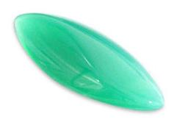
ASHER (Agate)
Meaning: “Asher” means joyful
Stone meaning: “Shevo” roots of this word meaning “shuv “– means to restore to life, to turn back, and to return
Prophecy: "Asher's food is rich — he will provide food fit for a king. (Genesis 49:20 CJB). The Hebrew word for bread is “Lechem” and it means food, grain, fruit, meat. It means any type of food. The word fat is “shamen” greasy plenteous rich, the root word is oily , to shine or richly anointed. The symbol of the tribe of Asher, is the Olive tree, the symbol of Israel
Blessing: Of Asher he said: "May Asher be most blessed of sons, may he be the favorite among his brothers and bathe his feet in oil. May your bolts be of iron and bronze and your strength last as long as you live. (Deuteronomy 33:24-25 CJB). Asher is going to dip his foot into oil, oil is a symbol of Rauch ha Kodesh (Holy Spirit). Iron and bronze are a symbol of judgement in other words Asher would bring judgement on others because of his walk with the Holy Spirit.

Slide 48
TURN BACK
and wear on your feet the readiness that comes from the Good News of shalom. (Ephesians 6:15 CJB)
When we are fitted to go fort and proclaim the gospel we have a walk of judgement , but it is a anointed walk. (We will always be judged according to what we say and do).
But first we have to turn back
From that time on, Yeshua began proclaiming, "Turn from your sins to God, for the Kingdom of Heaven is near!“ (Matthew 4:17 CJB)
A primitive root of “Shuva” to turn back, to repent from old ways “Teshuvah” repentance. I am sorry is not true repentance but rather to turn away from old ways.
But as for those who turn aside to their own crooked ways, may Adonai turn them away, along with those who do evil. Shalom on Isra'el! (Psalms 125:5 CJB)

Slide 49
WARFARE
Asher did not drive out the inhabitants of `Akko, Tzidon, Achlav, Akhziv, Helbah, Afik or Rechov; (Judges 1:31 CJB), Judges 5:17-18
They don’t like conflict and would rather stay in a safe haven. They would rather take on the ways of the others and their God’s before they enter into conflict for the will of God.
Where it was their weakness it also became their strength.
All these were descendants of Asher, leaders of their fathers' clans, elite, strong, brave men, the most important of the princes. Those fit for battle service, listed in genealogies, numbered 26,000 men. (1 Chronicles 7:40 CJB)

Slide 50
THE FATHER RUNS
Don't be like your ancestors, or like your kinsmen who sinned against Adonai the God of their ancestors, with the result that he allowed them to become an object of horror, as you see. Don't be stiffnecked now, as your ancestors were. Instead, yield yourselves to Adonai; enter his sanctuary, which he has made holy forever; and serve Adonai your God; so that his fierce anger will turn away from you. (2 Chronicles 30:7-8 CJB)
Come, let us return to Adonai; for he has torn, and he will heal us; he has struck, and he will bind our wounds. (Hosea 6:1 CJB)
The father will meet you:
So he got up and started back to his father. "But while he was still a long way off, his father saw him and was moved with pity. He ran and threw his arms around him and kissed him warmly. (Luke 15:20 CJB)
When we turn to the Father, He does not meet us halfway He does most of the work, He runs towards you because you have accepted the way He has made for you.

Slide 51
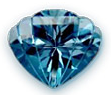
SIMEON (Topaz)
Meaning: “hears and obey” Genesis 29:33
Stone meaning: Pitdah, root is “phatad” to be pure
Prophecy: "Shim`on and Levi are brothers, related by weapons of violence. Let me not enter their council, let my honor not be connected with their people; for in their anger they killed men, and at their whim they maimed cattle. Cursed be their anger, for it has been fierce; their fury, for it has been cruel. I will divide them in Ya`akov and scatter them in Isra'el. (Genesis 49:5-7 CJB)
One of the problems of the Old Covenant as that it was impossible for anybody to live pure. In Genesis 34 Simeon and Levi killed the person who raped Dinah their sister including their entire family after Abraham had already made arrangements for restitution. Un-forgiveness and hard heart the opposite of purity.

Slide 52
REALITY (TODAY)
Therefore, dear friends, as you look for these things, do everything you can to be found by him without spot or defect and at peace. (2 Peter 3:14 CJB)
And everyone who has this hope in him continues purifying himself, since God is pure. (1 John 3:3 CJB)
We are instructed to live at our best in purity and peace an glistening example of the life Jesus portrayed while on earth.
So imitate God, as his dear children; and live a life of love, just as also the Messiah loved us, indeed, on our behalf gave himself up as an offering, as a slaughtered sacrifice to God with a pleasing fragrance. Among you there should not even be mentioned sexual immorality, or any kind of impurity, or greed; these are utterly inappropriate for God's holy people. Also out of place are obscenity and stupid talk or coarse language; instead, you should be giving thanks. For of this you can be sure: every sexually immoral, impure or greedy person — that is, every idol-worshipper — has no share in the Kingdom of the Messiah and of God. (Ephesians 5:1-5 CJB)

Slide 53
QUALITIES OF THE 12 TRIBES
Reuben – Submission to Yahweh
Simeon – To be pure
Levi – To give light
Judah – Instruction of Yahweh
Dan – Book of Yahweh
Naphtali – To heal
Zebulun – To reverence Yahweh
Joseph – Zeal for Yahweh
Benjamin – Yahweh our strength
Gad – Yahweh name and authority
Asher – To restore to life, return to Yahweh
Issachar – To join closely

Slide 54
12 FOUNDATION STONES
The foundations of the city wall were decorated with all kinds of precious stones — the first foundation stone was diamond, the second sapphire, the third chalcedony, the fourth emerald, the fifth sardonyx, the sixth carnelian, the seventh chrysolite, the eighth beryl, the ninth topaz, the tenth chrysoprase, the eleventh turquoise and the twelfth amethyst.
(Revelation 21:19-20 CJB)

Slide 55
CORRUPTED QUALITIES
Reuben - Ruby – Submission to Rebellion
Simeon - Topaz – To be pure to unclean
Levi - Emerald –To give light to darkness or ignorance
Judah - Turquoise – Instruction of Yahweh to no law
Dan - Sapphire – Book of Yahweh to half truth
Naphtali - Diamond – To heal to sickness and disease
Zebulun - Beryl – To reverence Yahweh to irreverence, profane, make common
Joseph - Shoham – Zeal for Yahweh to lukewarmness, indifference
Benjamin - Jasper – Yahweh our strength to trying to rely on your own flesh, your own strength to get things accomplished

Slide 56
SATAN’S BREASTPLATE
"Human being, raise a lament for the king of Tzor, and tell him that Adonai Elohim says: 'You put the seal on perfection; you were full of wisdom and perfect in beauty; you were in `Eden, the garden of God; covered with all kinds of precious stones — carnelians, topaz, diamonds, beryl, onyx, jasper, sapphires, green feldspar, emeralds; your pendants and jewels were made of gold, prepared the day you were created. You were a keruv, protecting a large region; I placed you on God's holy mountain. You walked back and forth among stones of fire. You were perfect in your ways from the day you were created, until unrighteousness was found in you. (Ezekiel 28:12-15 CJB)
Satan had 9 of the 12 stones as studied in Yahweh Shammah

Slide 57
MISSING CHARACTERISTICS
Jacinth – The name of Yahweh
Satan lost the right to the Name of Yahweh and all the authority that goes with it.
Agate – to restore to life, to return to Yahweh
Satan has lost the right to repent
Amethyst – to join closely
Satan has no right to covenants or blessings

